Slide 1

Notes:
Source: Oxford International Lower Secondary Computing Student Book 8, 2.2 Using computers for discovery, printed pages 38–41. Additional accuracy references: https://www.usgs.gov/faqs/can-you-predict-earthquakes https://science.nasa.gov/mission/mer-spirit/ https://www.fda.gov/science-research/about-science-research-fda/modeling-simulation-fda Visuals are generated conceptual illustrations.

Slide 2

Notes:
Source: Oxford International Lower Secondary Computing Student Book 8, 2.2 Using computers for discovery, printed pages 38–41. Additional accuracy references: https://www.usgs.gov/faqs/can-you-predict-earthquakes https://science.nasa.gov/mission/mer-spirit/ https://www.fda.gov/science-research/about-science-research-fda/modeling-simulation-fda Visuals are generated conceptual illustrations.

Slide 3
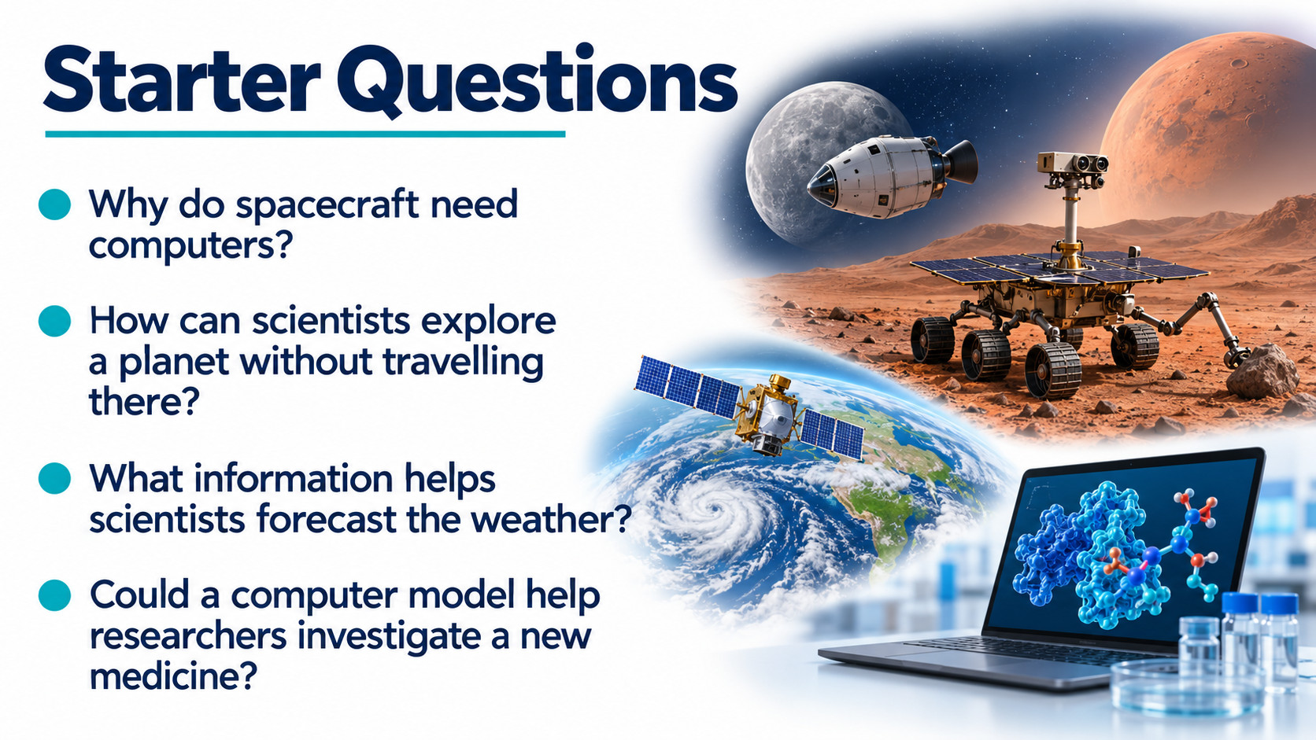
Notes:
Source: Oxford International Lower Secondary Computing Student Book 8, 2.2 Using computers for discovery, printed pages 38–41. Additional accuracy references: https://www.usgs.gov/faqs/can-you-predict-earthquakes https://science.nasa.gov/mission/mer-spirit/ https://www.fda.gov/science-research/about-science-research-fda/modeling-simulation-fda Visuals are generated conceptual illustrations.

Slide 4
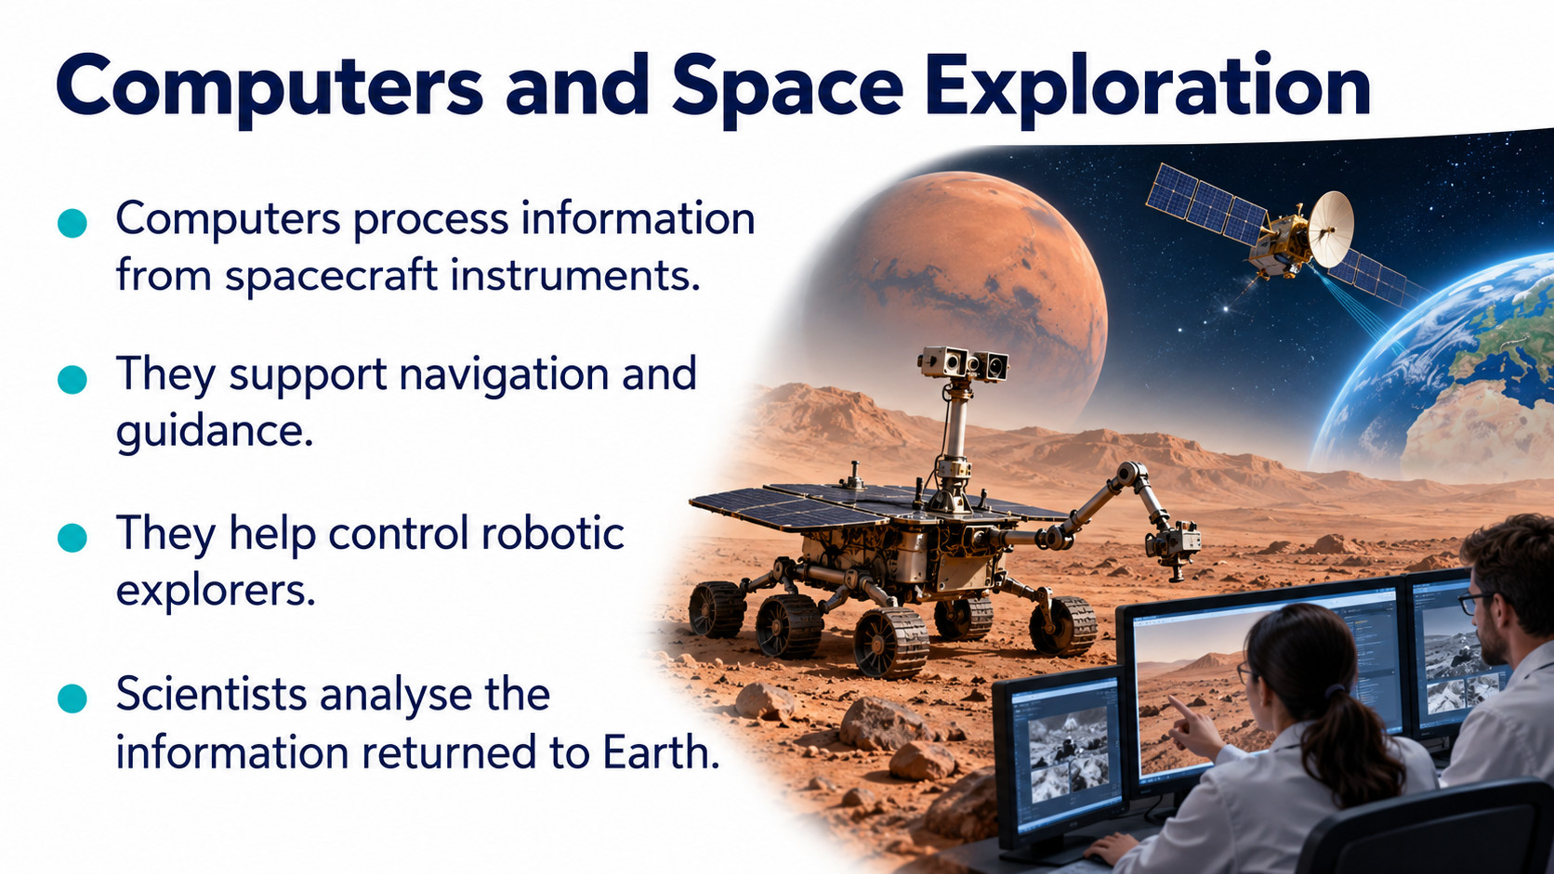
Notes:
Source: Oxford International Lower Secondary Computing Student Book 8, 2.2 Using computers for discovery, printed pages 38–41. Additional accuracy references: https://www.usgs.gov/faqs/can-you-predict-earthquakes https://science.nasa.gov/mission/mer-spirit/ https://www.fda.gov/science-research/about-science-research-fda/modeling-simulation-fda Visuals are generated conceptual illustrations.

Slide 5
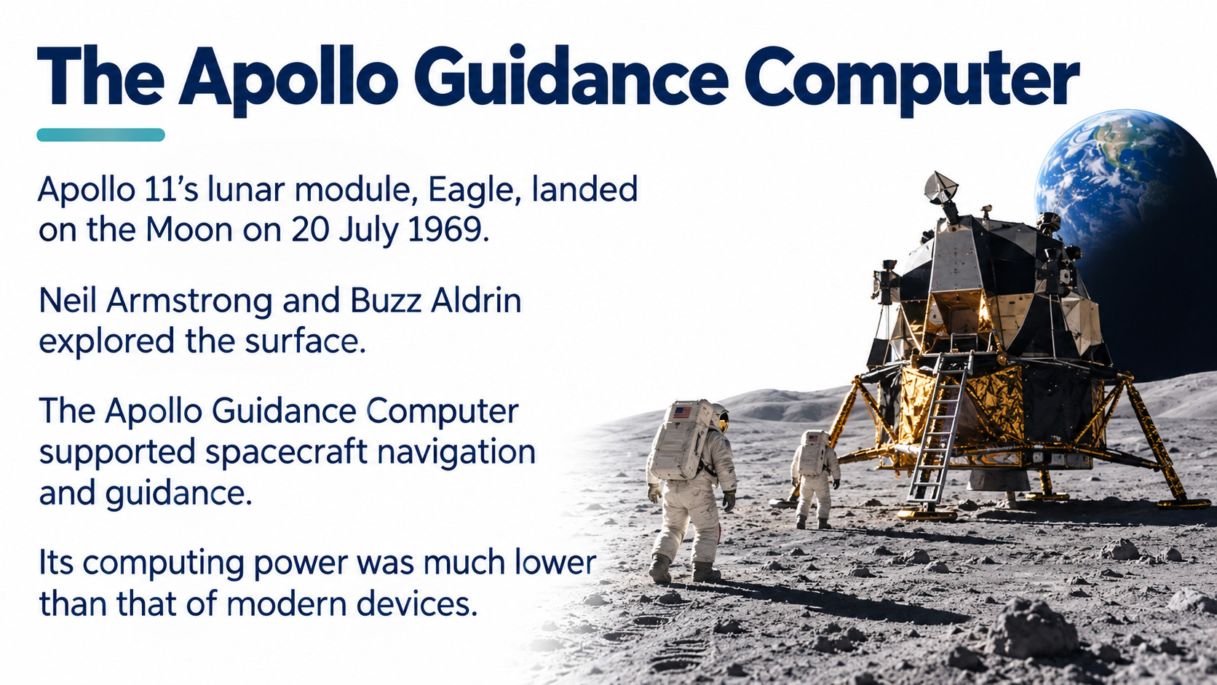
Notes:
Source: Oxford International Lower Secondary Computing Student Book 8, 2.2 Using computers for discovery, printed pages 38–41. Additional accuracy references: https://www.usgs.gov/faqs/can-you-predict-earthquakes https://science.nasa.gov/mission/mer-spirit/ https://www.fda.gov/science-research/about-science-research-fda/modeling-simulation-fda Visuals are generated conceptual illustrations.

Slide 6
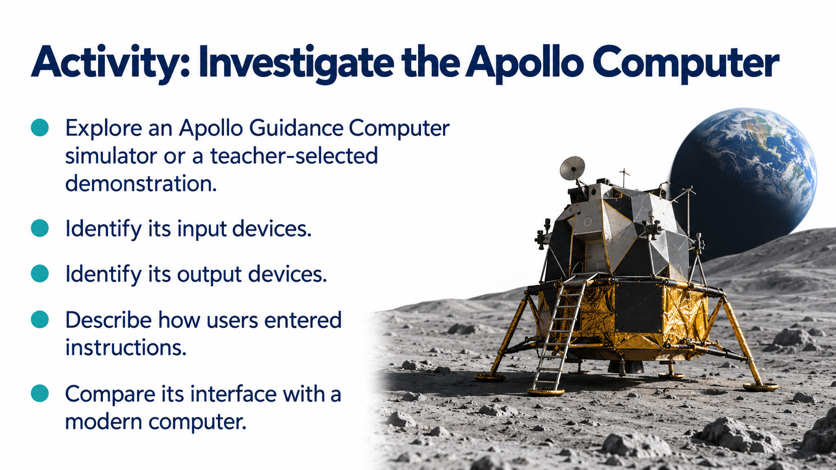
Notes:
Source: Oxford International Lower Secondary Computing Student Book 8, 2.2 Using computers for discovery, printed pages 38–41. Additional accuracy references: https://www.usgs.gov/faqs/can-you-predict-earthquakes https://science.nasa.gov/mission/mer-spirit/ https://www.fda.gov/science-research/about-science-research-fda/modeling-simulation-fda Visuals are generated conceptual illustrations.

Slide 7
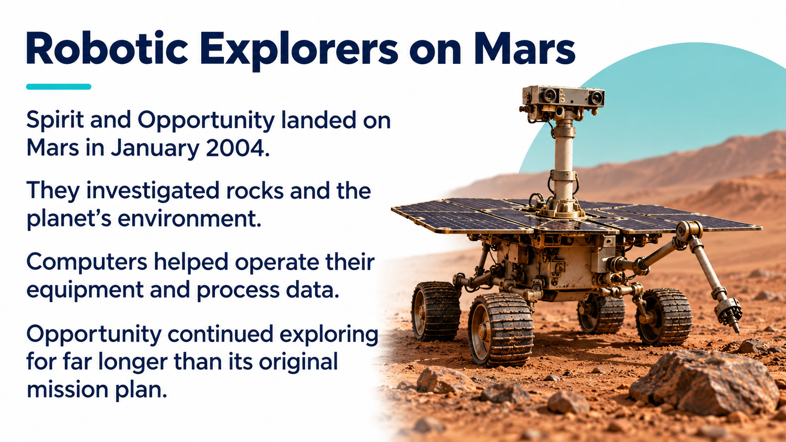
Notes:
Source: Oxford International Lower Secondary Computing Student Book 8, 2.2 Using computers for discovery, printed pages 38–41. Additional accuracy references: https://www.usgs.gov/faqs/can-you-predict-earthquakes https://science.nasa.gov/mission/mer-spirit/ https://www.fda.gov/science-research/about-science-research-fda/modeling-simulation-fda Visuals are generated conceptual illustrations.

Slide 8
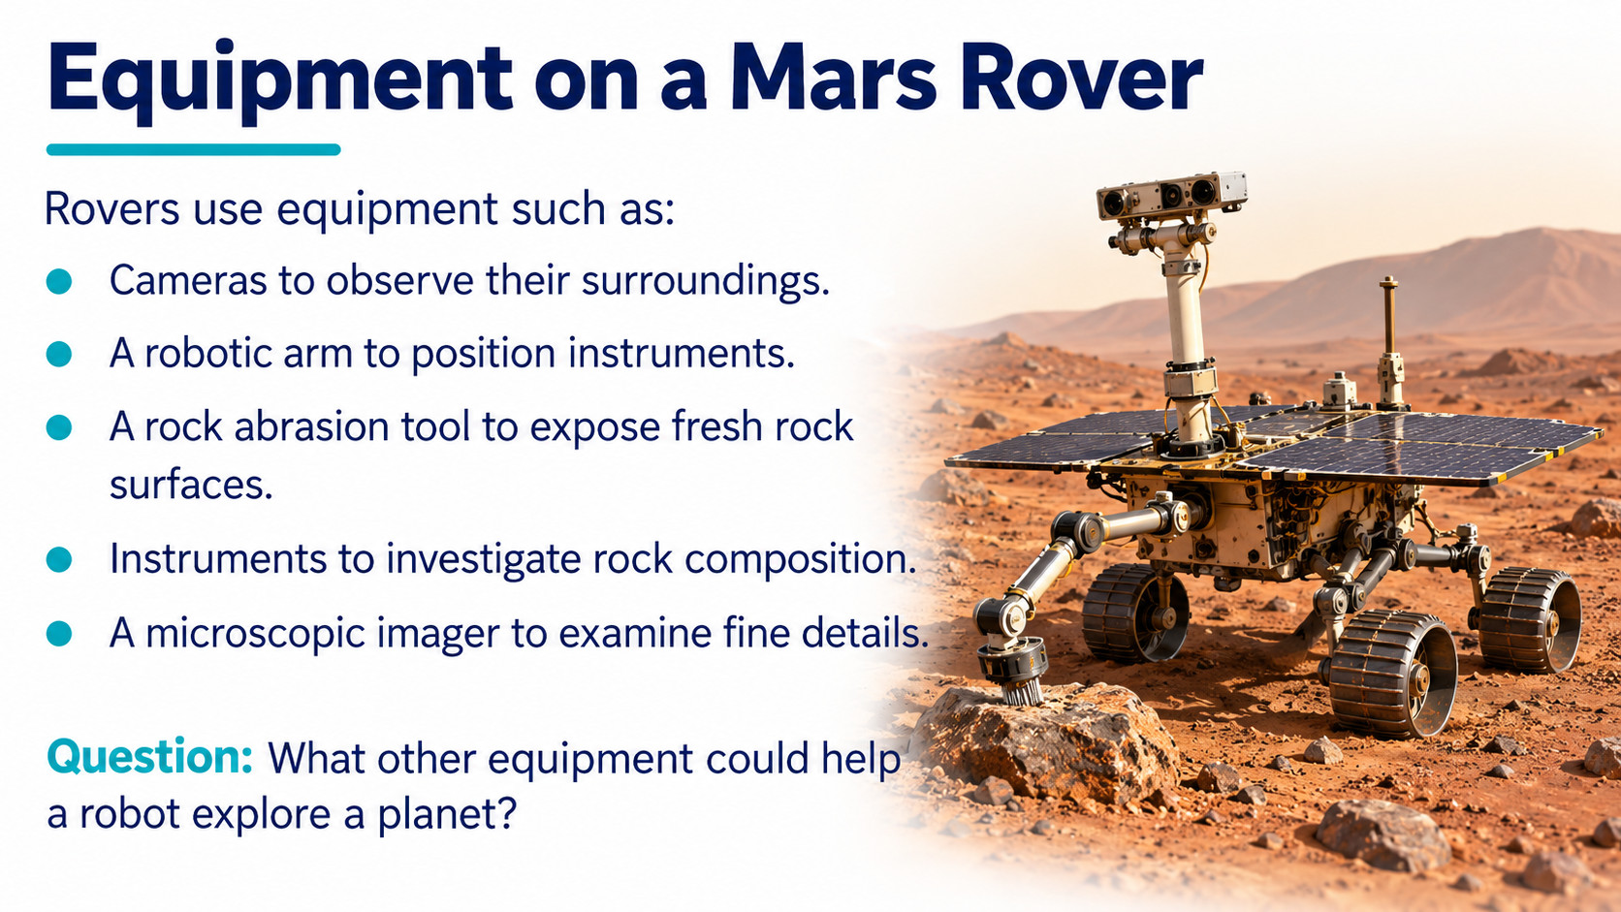
Notes:
Source: Oxford International Lower Secondary Computing Student Book 8, 2.2 Using computers for discovery, printed pages 38–41. Additional accuracy references: https://www.usgs.gov/faqs/can-you-predict-earthquakes https://science.nasa.gov/mission/mer-spirit/ https://www.fda.gov/science-research/about-science-research-fda/modeling-simulation-fda Visuals are generated conceptual illustrations.

Slide 9
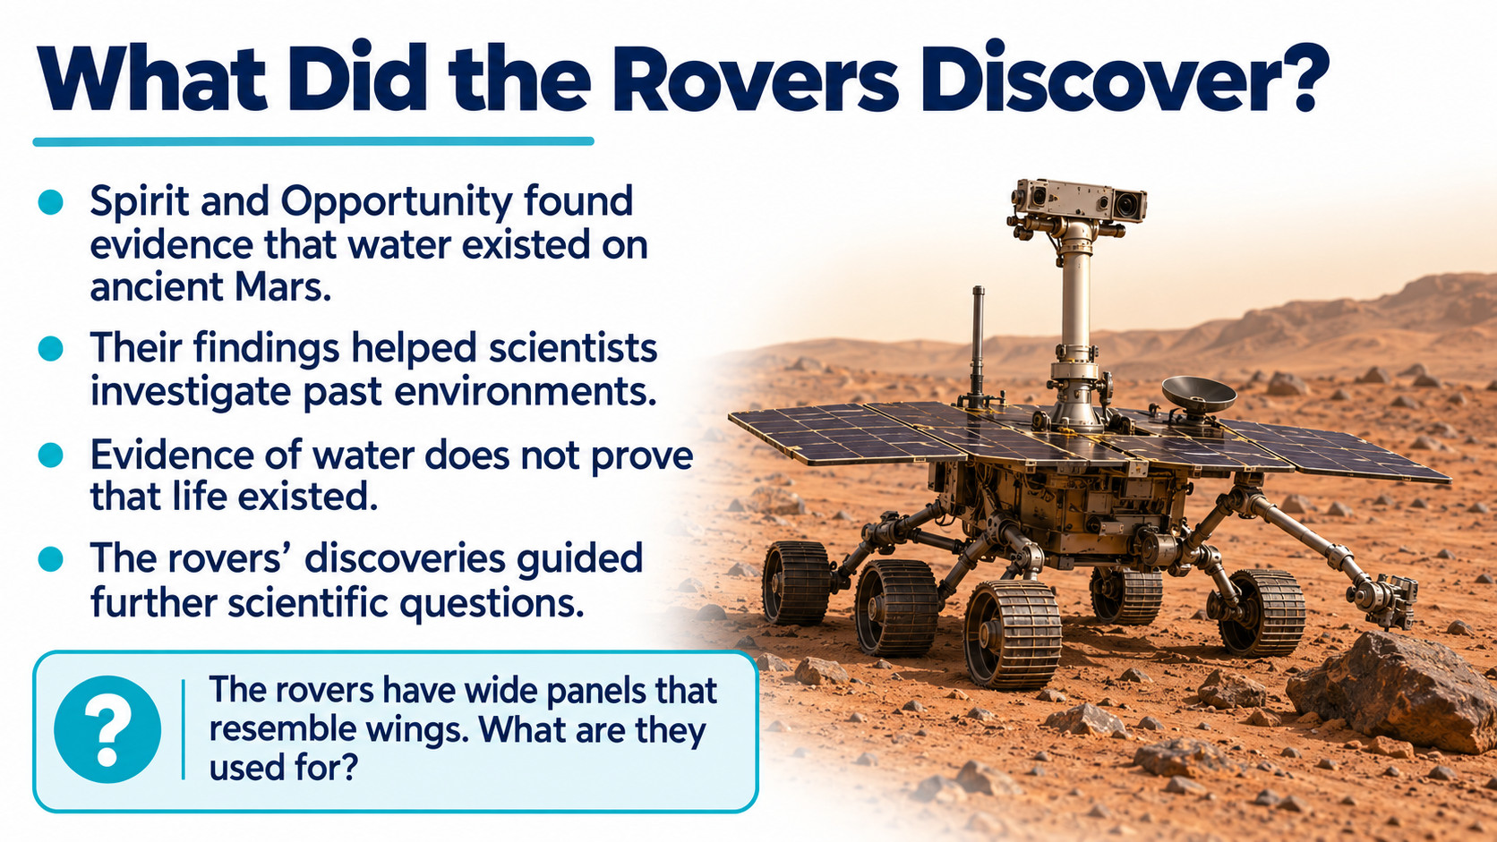
Notes:
Source: Oxford International Lower Secondary Computing Student Book 8, 2.2 Using computers for discovery, printed pages 38–41. Additional accuracy references: https://www.usgs.gov/faqs/can-you-predict-earthquakes https://science.nasa.gov/mission/mer-spirit/ https://www.fda.gov/science-research/about-science-research-fda/modeling-simulation-fda Visuals are generated conceptual illustrations.

Slide 10
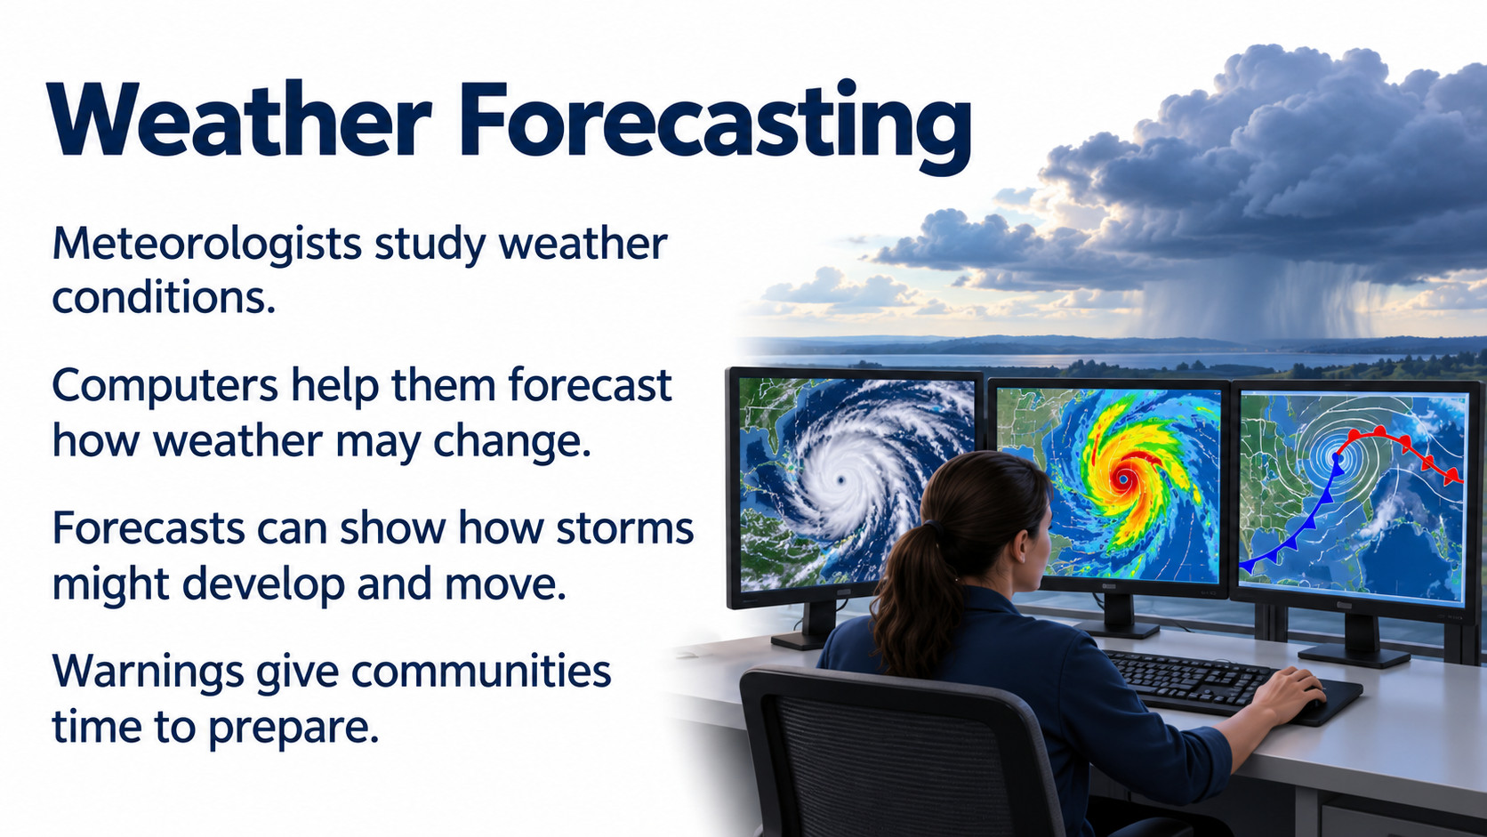
Notes:
Source: Oxford International Lower Secondary Computing Student Book 8, 2.2 Using computers for discovery, printed pages 38–41. Additional accuracy references: https://www.usgs.gov/faqs/can-you-predict-earthquakes https://science.nasa.gov/mission/mer-spirit/ https://www.fda.gov/science-research/about-science-research-fda/modeling-simulation-fda Visuals are generated conceptual illustrations.

Slide 11
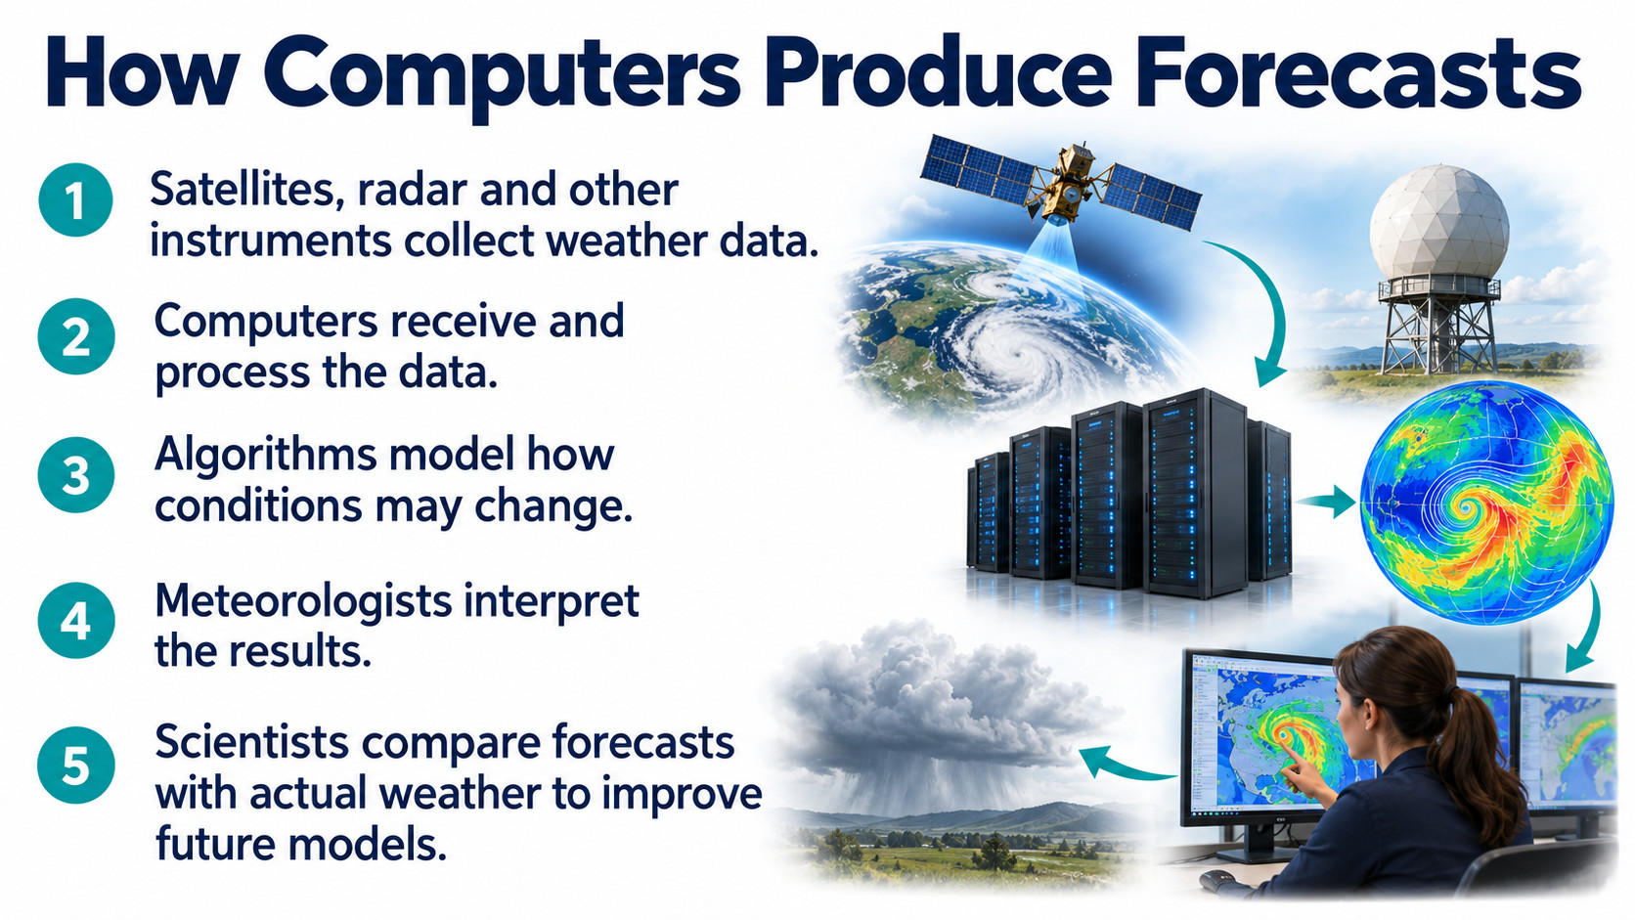
Notes:
Source: Oxford International Lower Secondary Computing Student Book 8, 2.2 Using computers for discovery, printed pages 38–41. Additional accuracy references: https://www.usgs.gov/faqs/can-you-predict-earthquakes https://science.nasa.gov/mission/mer-spirit/ https://www.fda.gov/science-research/about-science-research-fda/modeling-simulation-fda Visuals are generated conceptual illustrations.

Slide 12
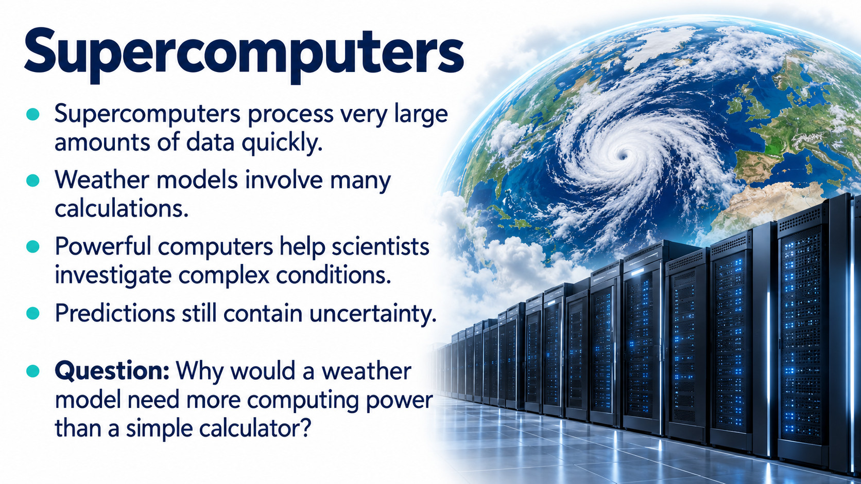
Notes:
Source: Oxford International Lower Secondary Computing Student Book 8, 2.2 Using computers for discovery, printed pages 38–41. Additional accuracy references: https://www.usgs.gov/faqs/can-you-predict-earthquakes https://science.nasa.gov/mission/mer-spirit/ https://www.fda.gov/science-research/about-science-research-fda/modeling-simulation-fda Visuals are generated conceptual illustrations.

Slide 13
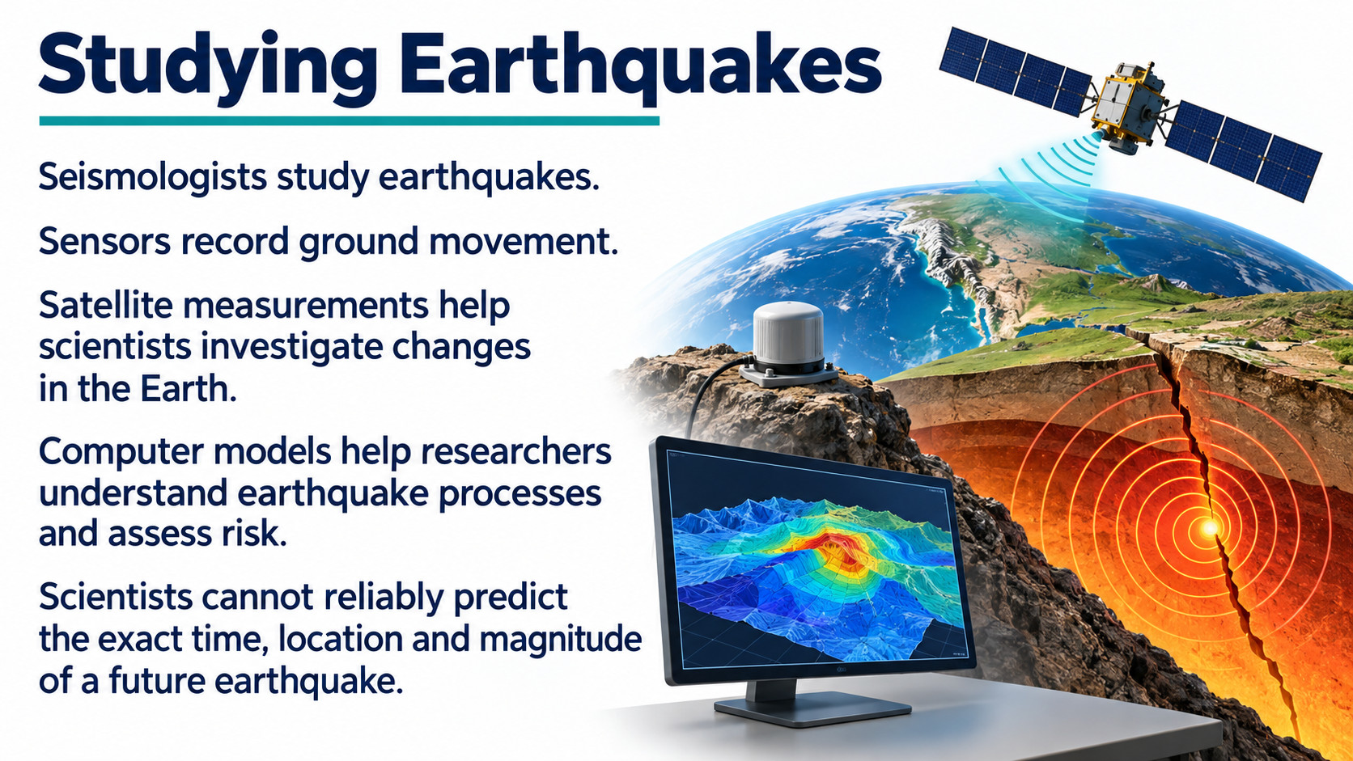
Notes:
Source: Oxford International Lower Secondary Computing Student Book 8, 2.2 Using computers for discovery, printed pages 38–41. Additional accuracy references: https://www.usgs.gov/faqs/can-you-predict-earthquakes https://science.nasa.gov/mission/mer-spirit/ https://www.fda.gov/science-research/about-science-research-fda/modeling-simulation-fda Visuals are generated conceptual illustrations.

Slide 14
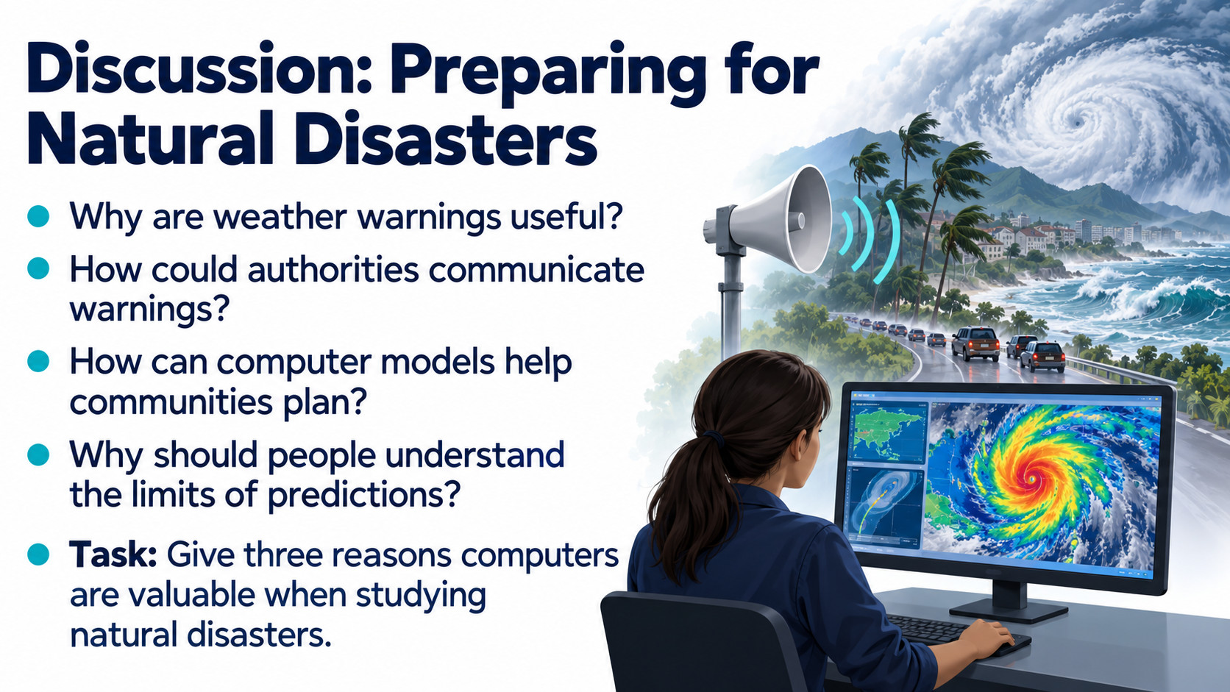
Notes:
Source: Oxford International Lower Secondary Computing Student Book 8, 2.2 Using computers for discovery, printed pages 38–41. Additional accuracy references: https://www.usgs.gov/faqs/can-you-predict-earthquakes https://science.nasa.gov/mission/mer-spirit/ https://www.fda.gov/science-research/about-science-research-fda/modeling-simulation-fda Visuals are generated conceptual illustrations.

Slide 15
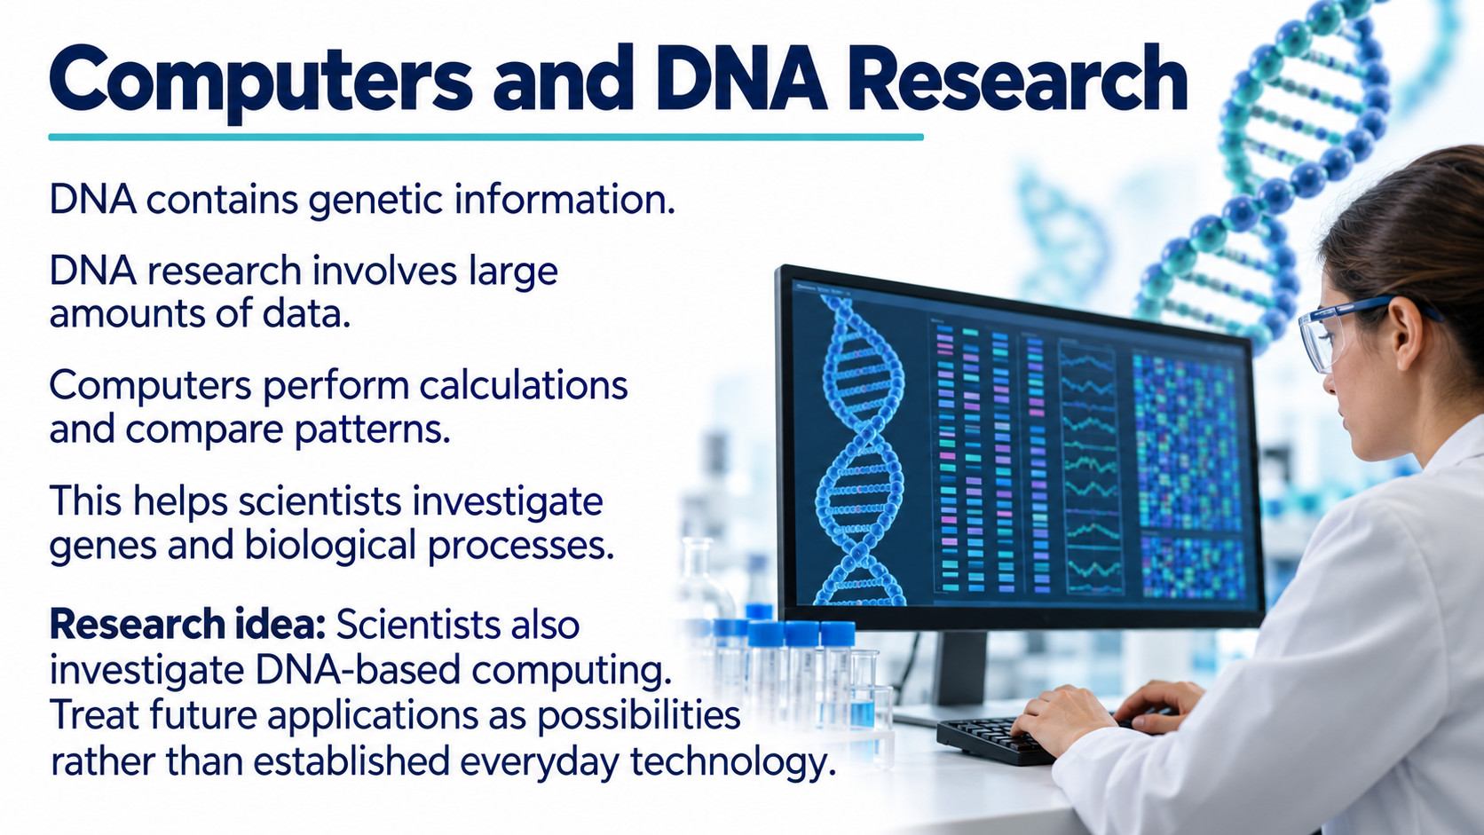
Notes:
Source: Oxford International Lower Secondary Computing Student Book 8, 2.2 Using computers for discovery, printed pages 38–41. Additional accuracy references: https://www.usgs.gov/faqs/can-you-predict-earthquakes https://science.nasa.gov/mission/mer-spirit/ https://www.fda.gov/science-research/about-science-research-fda/modeling-simulation-fda Visuals are generated conceptual illustrations.

Slide 16
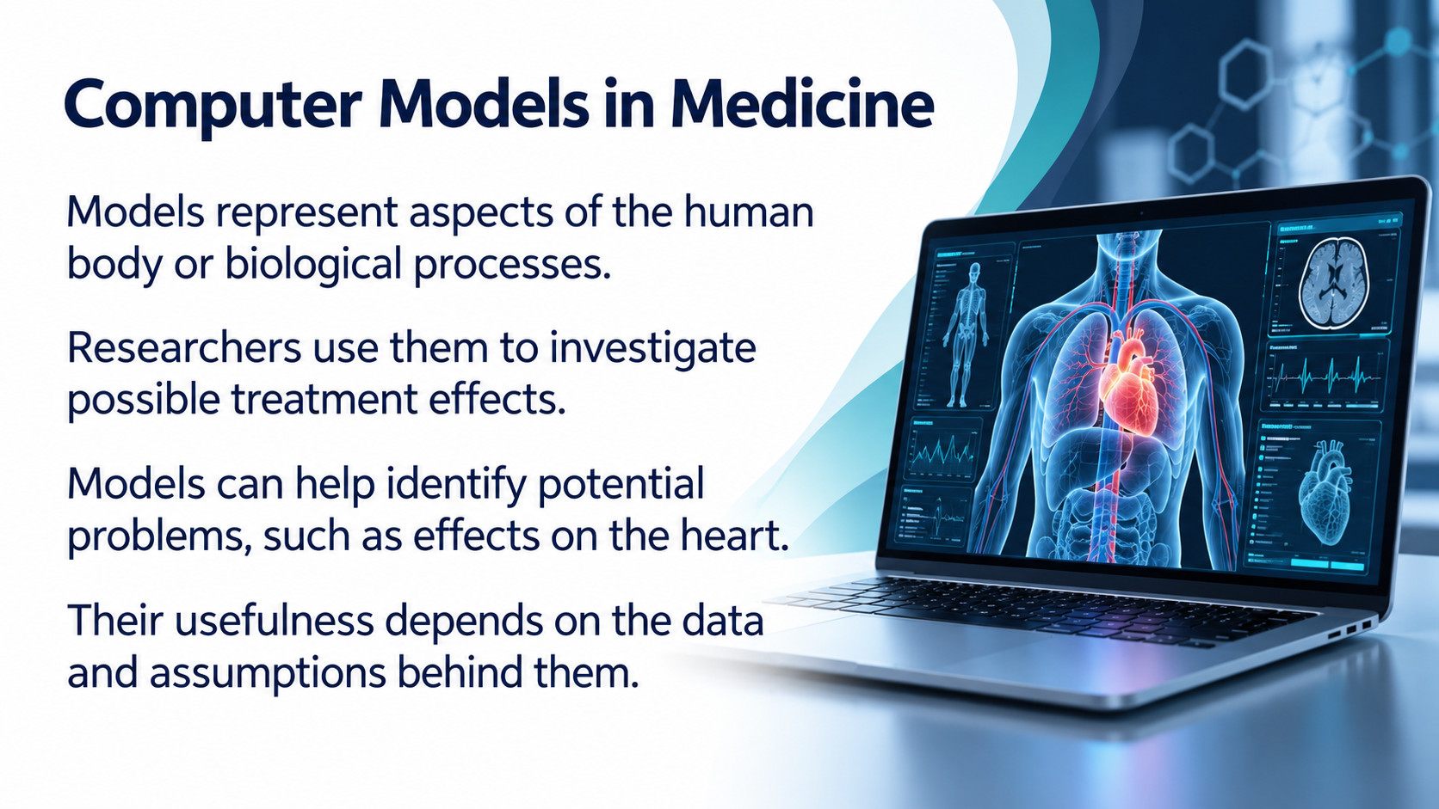
Notes:
Source: Oxford International Lower Secondary Computing Student Book 8, 2.2 Using computers for discovery, printed pages 38–41. Additional accuracy references: https://www.usgs.gov/faqs/can-you-predict-earthquakes https://science.nasa.gov/mission/mer-spirit/ https://www.fda.gov/science-research/about-science-research-fda/modeling-simulation-fda Visuals are generated conceptual illustrations.

Slide 17
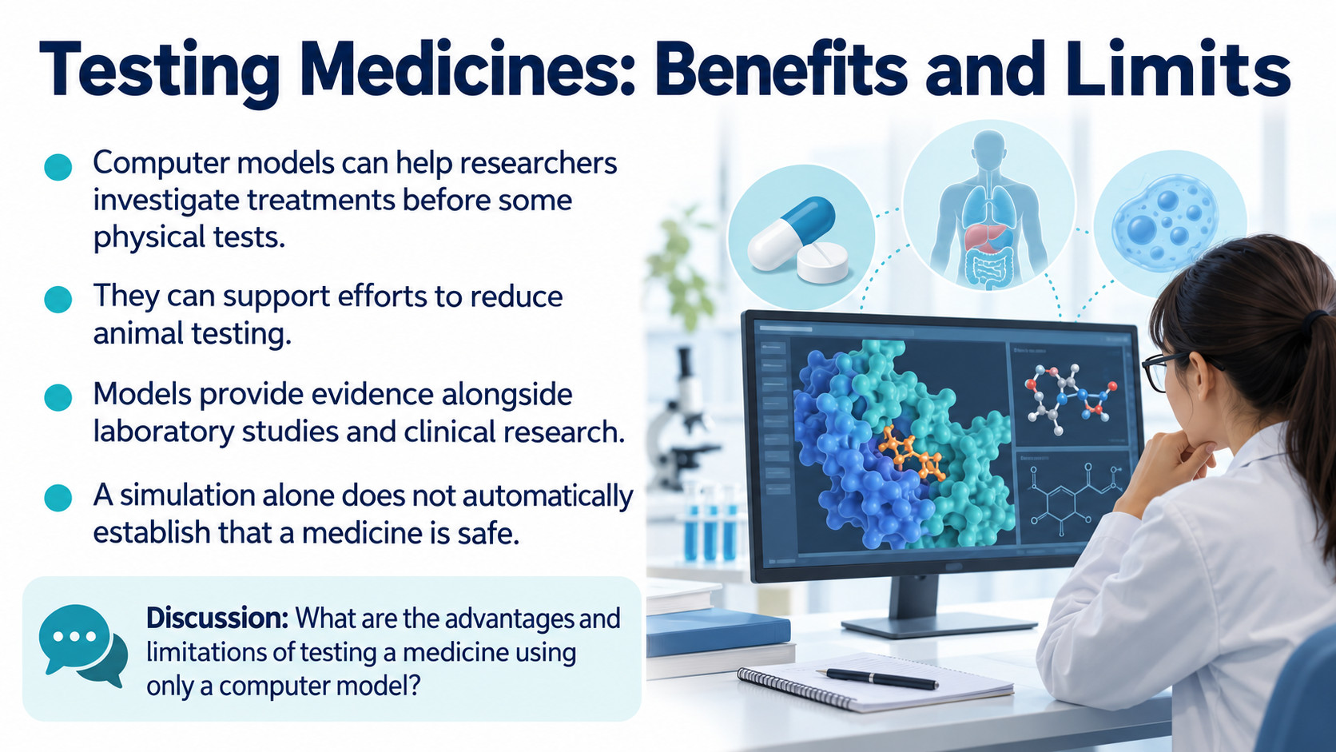
Notes:
Source: Oxford International Lower Secondary Computing Student Book 8, 2.2 Using computers for discovery, printed pages 38–41. Additional accuracy references: https://www.usgs.gov/faqs/can-you-predict-earthquakes https://science.nasa.gov/mission/mer-spirit/ https://www.fda.gov/science-research/about-science-research-fda/modeling-simulation-fda Visuals are generated conceptual illustrations.

Slide 18
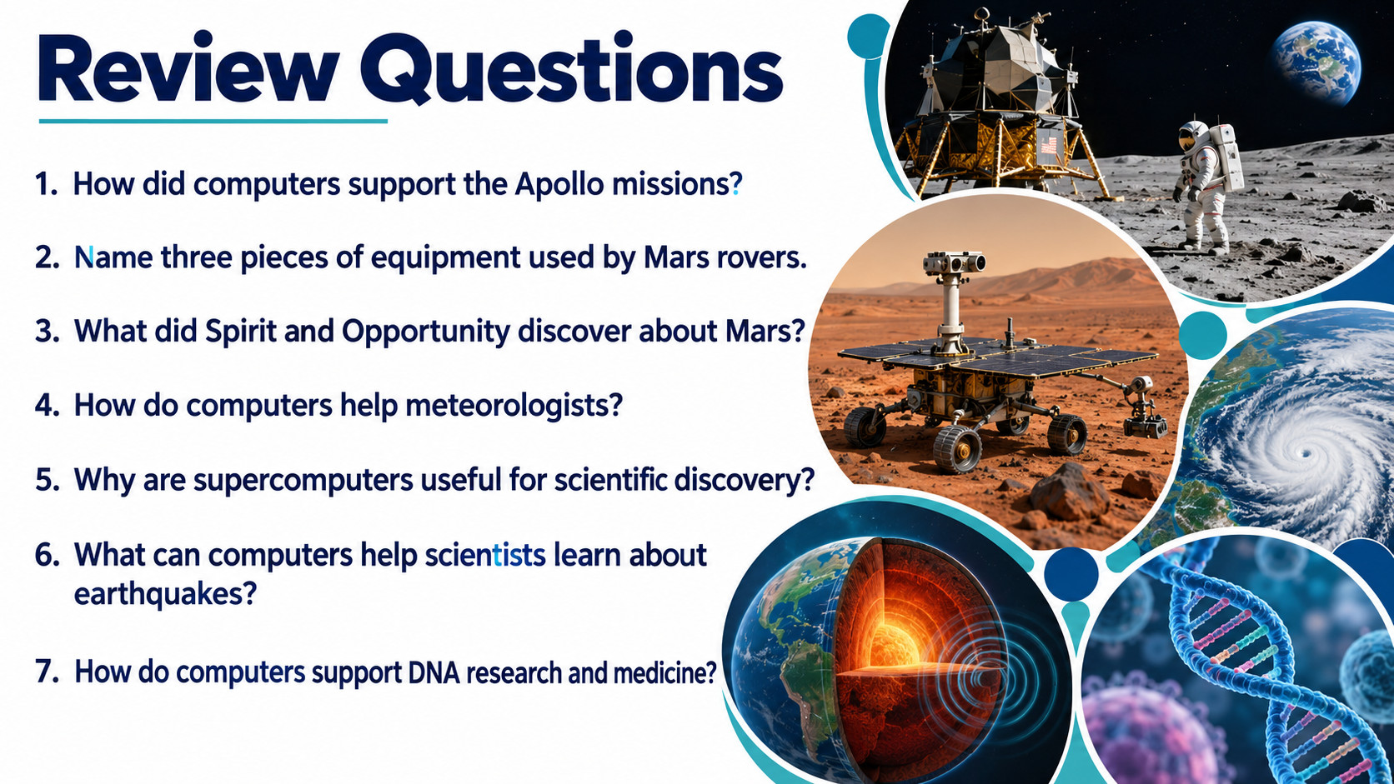
Notes:
Source: Oxford International Lower Secondary Computing Student Book 8, 2.2 Using computers for discovery, printed pages 38–41. Additional accuracy references: https://www.usgs.gov/faqs/can-you-predict-earthquakes https://science.nasa.gov/mission/mer-spirit/ https://www.fda.gov/science-research/about-science-research-fda/modeling-simulation-fda Visuals are generated conceptual illustrations.

